Slide 1
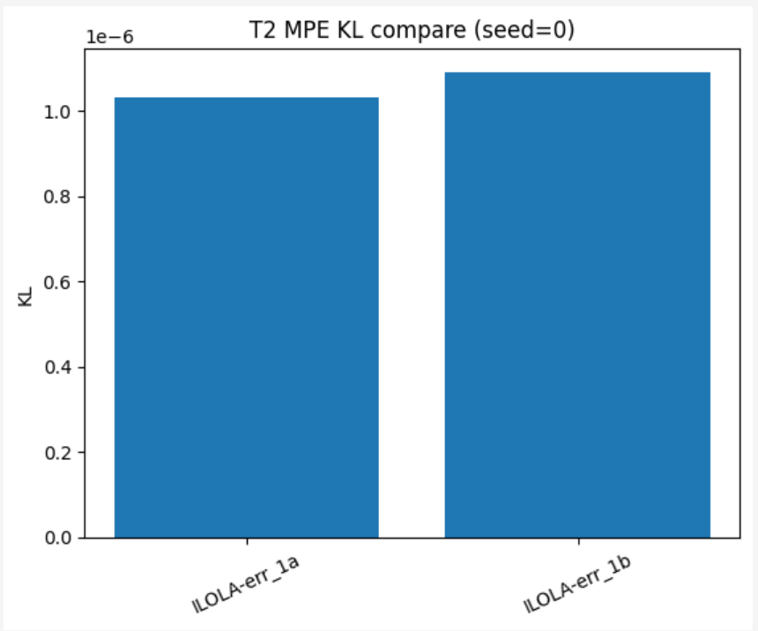
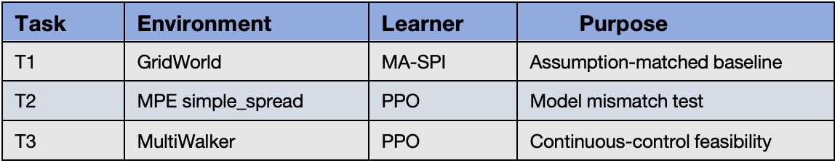
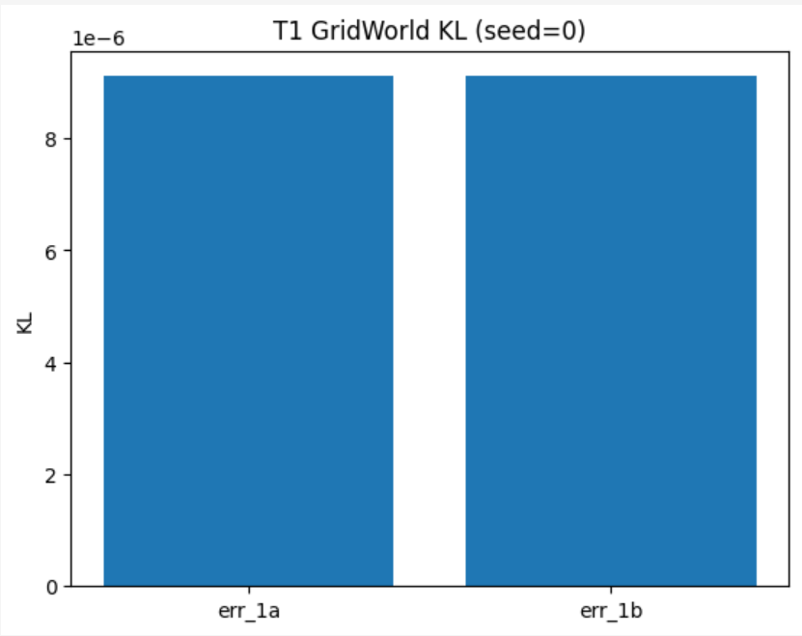
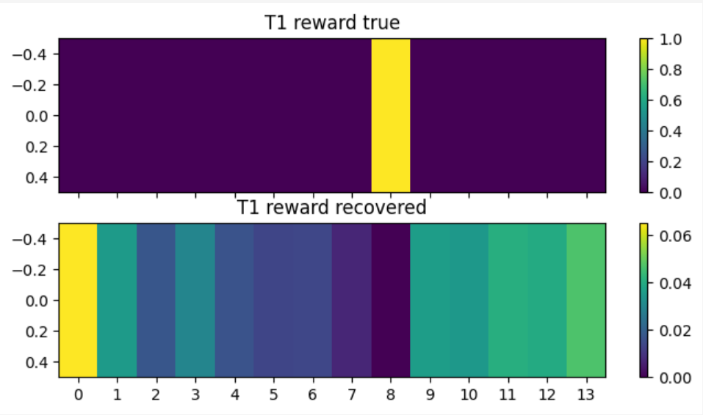
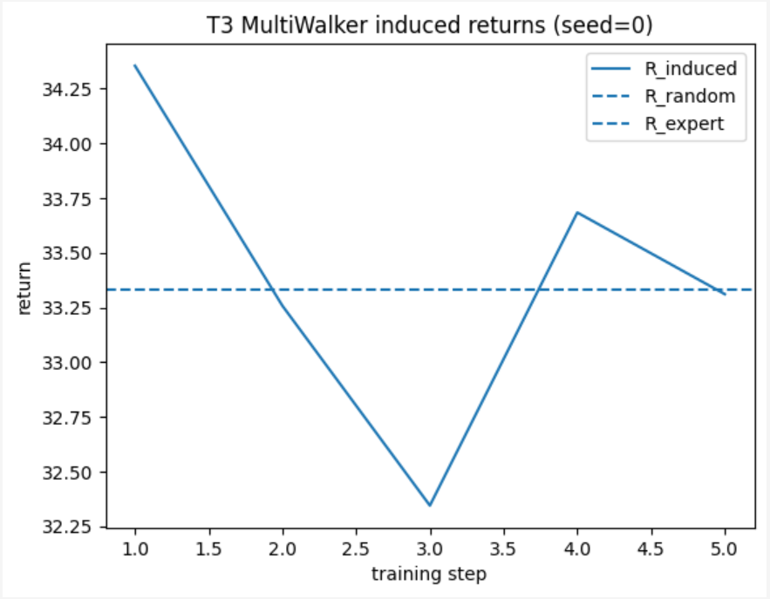
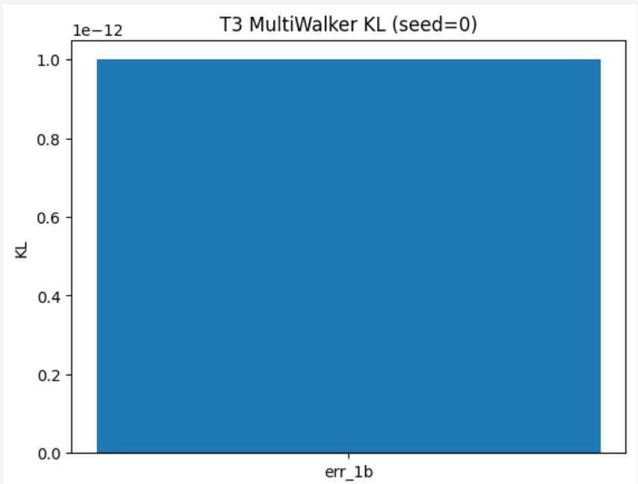
Inverse Learning from Gradient-Based Multi-Agent Learners (I-LOLA)
Zhongjian Yu, Yutian Lei, Zhengxun Yin, Chengrui Gao, Maorong Lin
1. Motivation & Problem
4. Experimental Setup
5.2 Results — T2 MPE (PPO)
Inverse Reinforcement Learning (IRL) aims to recover an underlying reward function from observed agent behavior.
Most existing multi-agent IRL methods assume agents follow Multi-Agent Soft Policy Iteration (MA-SPI), which:
A.works well in small, discrete environments;
B.is incompatible with modern gradient-based learners (e.g.policy gradient &PPO)
However, in realistic multi-agent systems:
A.agents are learning, not optimal;
B.policies evolve through gradient updates;
C.learning dynamics themselves contain reward information
💡Can we perform inverse learning directly from gradient-based multi-agent learners?
We evaluate across three increasingly realistic environments:
Learners trained with PPO (violating MA-SPI assumptions)
I-LOLA achieves:
KL(1a) ≈ 1.03×10⁻⁶
KL(1b) ≈ 1.09×10⁻⁶
Key result:
Recovered rewards predict future policy updates almost as accurately as true rewards.
Metrics:
KL(1a): prediction error using true reward
KL(1b): prediction error using recovered reward
Induced return: usefulness of recovered reward
Figure 3: T2 PPO KL comparison
2. Challenges
5.3Results — T3 MultiWalker
Model mismatch: MA-SPI assumptions vs PPO learners
Coupled learning: agents adapt while anticipating others
Reward ambiguity: different rewards may induce identical behavior
3. Method Overview
We extend LOGEL (Inverse RL from a Gradient-Based Learner) to multi-agent settings by explicitly modeling learning interactions.
Key ideas:
Treat agents as learners, not equilibria
Infer rewards from policy updates, not final policies
Model opponent learning via LOLA
Two stages:
Stage A (I-LOGEL): independent learners
Stage B (I-LOLA): coupled learning dynamics
Optimization uses black-box CMA-ES, avoiding second-order gradients.
Figure 4: T3 KL (Monte Carlo)
Continuous-action, multi-agent physical environment
MA-LfL not applicable
I-LOLA remains numerically stable: Monte Carlo KL ≈ 5×10⁻⁴
Figure 5: T3 induced returns
Induced policies achieve performance comparable to random baseline
Indicates recovered reward contains usable signal
Further optimization required
Figure 1: T1 KL comparison
Figure 2: T1 reward heatmap
5.1 Results — T1 GridWorld
6. Takeaways & Limitations
KL(1a) ≈ KL(1b) ≈ 9×10⁻⁶
MA-LfL accurately predicts policy updates
Recovered reward differs numerically but induces identical behavior
Interpretation:
MA-LfL works well when its assumptions hold.
Takeaways:
MA-LfL works when assumptions hold (T1)
I-LOLA remains accurate under PPO learners (T2)
Inverse learning is feasible in continuous control (T3)
Limitations
Single-seed experiments
No MA-LfL baseline in T2/T3
Induced performance not yet expert-level
M

